Slide 1


Slide 2

Offer
www.recruitment-test.co.uk for details on tests and assessments
Finance, Excel, Numeracy, Attention to detail and much more
Pay as you go no subscription, e.g. £3.99 with 100 credits no expiry
Add your questions and mix new e.g. £99 per 25 question load
We can load your long list of candidates or reusable link +£29 each batch load
Language changes £99 for 25 questions + translation cost
Relevant assessment - £80 for design & load, £1.20 per applicant
Other admin help - £35/hour

Slide 3
Useful links
Open An Account - https://www.recruitment-tests.co.uk/site/main/freetrial
Share with colleagues?
Log in : https://www.recruitment-tests.co.uk/site/client/login
IQ Test list - https://www.recruitment-tests.co.uk/site/main/freetrial
EQ Assessments - https://www.recruitment-tests.co.uk/site/main/eq
Prices PAYG - https://www.recruitment-tests.co.uk/site/main/pricing://youtu.be/jKCM7BRjSq4
Price guarantee if you find better, volume discounts offer after 200 tests

Slide 4
Index
Welcome to RT
Self service Testing Portal – you are in control
The candidate instructions & experience
Sending test link to multiple candidates
Candidate care options
Testing Candidates in your office (e.g. Assessment Centre)
Q & A

Slide 5
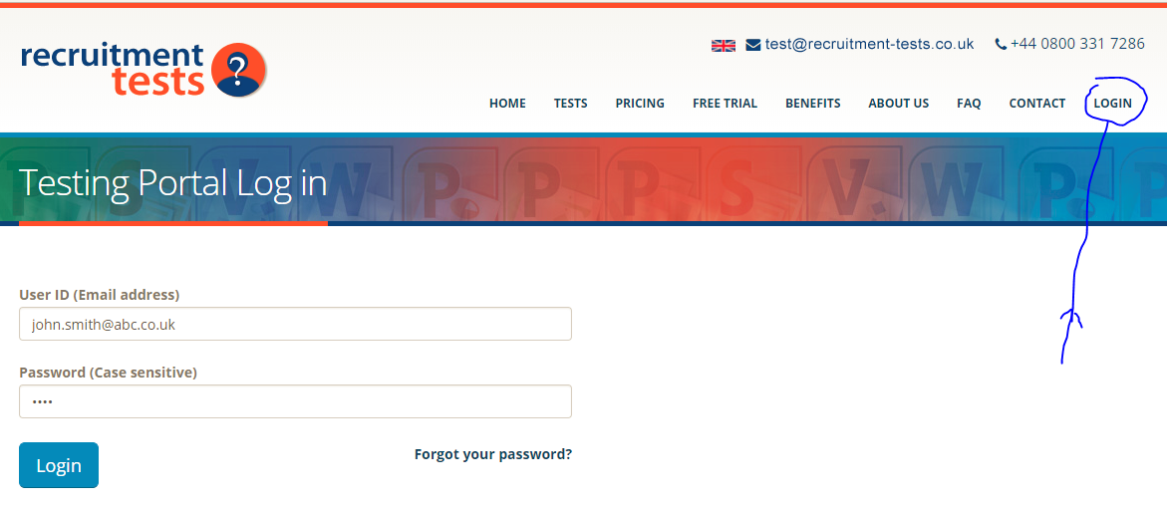
www.recruitment-tests.co.uk / Login tab / Email / “test”
Once you have registered at www.recruitment-tests.co.uk …. top right tab ‘login’ tab… your email as user ID, password “test”.

Slide 6
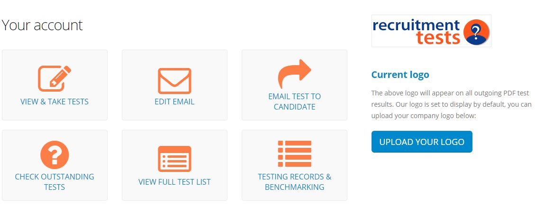
7 Testing Portal options - you are in control
Take test now, edit email invite, email test to candidate(s), check outstanding tests not yet taken, full test list, testing records and upload your own company logo. Excel download on outstanding tests and testing records. Log into our Testing Portal at www.recruitment-tests.co.uk (top right tab ‘log in’… your email as user ID).

Slide 7
Navigation guides
Navigation guides
The portal is self-service. You can find instruction videos below, should you need guidance on how to send etc.
Demonstration on just how easy it is to send out a assessments with Recruitment Tests.
Video: https://youtu.be/va4vMaWDmtQ
Demonstration on just how easy it is to personalise your platform with Recruitment Tests.
Video: https://youtu.be/2mm-zQLUKE0
Demonstration on just how easy it is to monitor outstanding assessments and your results with Recruitment Tests easy to use login.
Video: https://youtu.be/sCMjz84gEiE
Please ask your IT department to white list our domain (@test@recruitment-tests.co.uk) so that no result emails are lost into spam folders.

Slide 8

An example of instructions a candidate will receive after you have sent a test to them. Candidate receives one email per test which you send. The link in email can only be used once.
Please note the standard email which candidate receives has no user ID or password, only a unique link for them to click on to take the test. They can click the link many times but it will only become unavailable once they have clicked the button to ‘BEGIN THE TEST”.
In our portal you also have an option to edit the email which goes out to candidates.

Slide 9
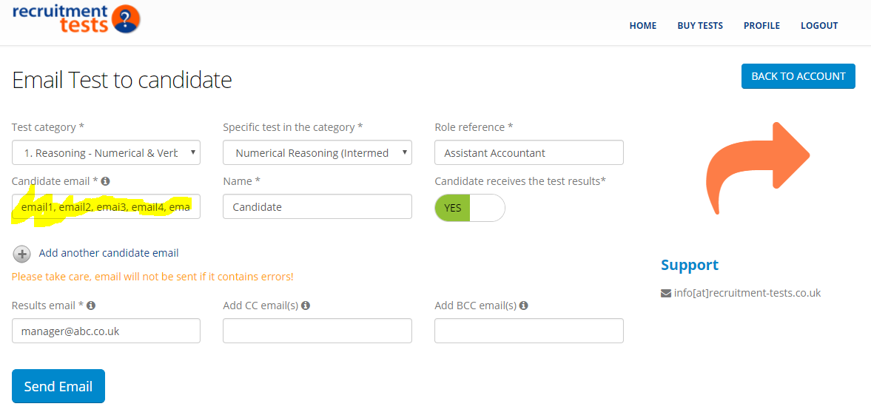
You can send the same test to numerous candidates at the same time:
HOW? If you would like to send the same test to numerous candidates at the same time, simply separate the email addresses with a comma and a space as per the image above. Our system will then confirm in a few seconds that emails were sent.
The fields you have already filled in will remain completed (if you don’t navigate away from this page), simply select a different test and press submit again to send a different test to the same candidates so there’s no need to re-populate the form.

Slide 10
If your candidate list is long (200 max), maybe the below will help send tests out once in one batch.
We can upload a large batch for you if you prefer.
Simply send us an Excel file with emails in a columns for your candidates and we can send all the tests out in 1 big batch all at once.
Or we can create you a reusable link, £30 + VAT each
Example below – relevance assessment -
https://iiop.co.uk/site/assessment/fcceb5cf-f2d3-491b-a7ce-7b46d67992f3

Slide 11
Candidate Care Options
Unfortunately despite our best efforts, a small number of candidates try to break our
standard system which works for 99.9% of other candidates every day
We find a very small number of candidates do the following:
Don’t read or follow the instructions (e.g. copy the link with no spaces into Chrome browser, and answer all questions).
Try to look at the test questions before they take the test for real (“Cheating” maybe?). To avoid this, the links work for one time only.
Try to take the test in a poor environment with noise and distraction etc.
Lose the email in their SPAM inbox and don’t look for it properly.
Say they took the test but haven’t received the results. This is because they close the browser or move away rather than submit the test by answering the last question and hitting ‘next’. Maybe thinking they didn’t do very well and they are trying to have another go or they did not notice they needed to answer the last question.
Then they say:
“The system doesn't work”
“I never got the test / email”
“I lost the internet on the train”
“I got one test and not another”
“I need a user ID and password”
“I did the test and no results”
We have many clients and candidates who are using our testing portal simultaneously every day. We can assure you the reasons given above are not due to our system failure. We have investigated all the statements above on numerous occasions and our system log files back this up – it is due to non proper use, usually those who are trying to ‘have another go’ etc.
The solution options:
Look in outstanding tests area for test sent. If found and to avoid using another test credit, copy the link to the candidate from here with your email (see next page).
If no outstanding test link and no results are found for the candidate it is most likely they killed the test after trying (unsuccessfully) to take a pre look. Your choice to send another test via our “Testing Portal”.
Ignore the candidate as everyone had the same chance at the beginning. From your point of view, a fair selection process.
You can also take our candidate care option where we can resend tests for you without further questions. This service has £7 charge per test due to the manual nature of the task.
Please email us at test@recruitment-tests.co.uk if you have any questions regarding candidates trying to cheat.

Slide 12
Anti Cheating measures (remote)
Unfortunately a small number of candidates try to cheat in one way or another when taking tests remote, unlike some testing companies we have a level playing field.
Our questions appear one at a time with no ability to move backwards. More than one question visible on the screen at one time and/or the ability to move forward and backwards may allow a candidates ‘friend’ to assist with the time pressure .
All tests have some time pressure.
All questions are designed such that Google or calculators will not help.
Tests can be sent indirect to host in the office on interview day (if physically present).
For some extra cost we in the future offer proctoring services.

Slide 13
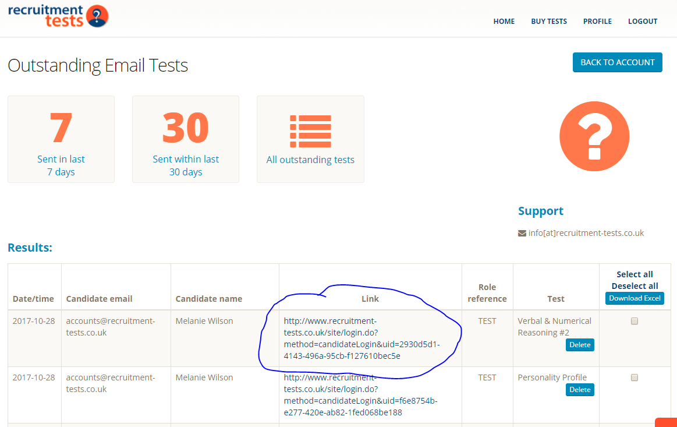
Copy test link to candidate if email not found.

Slide 14
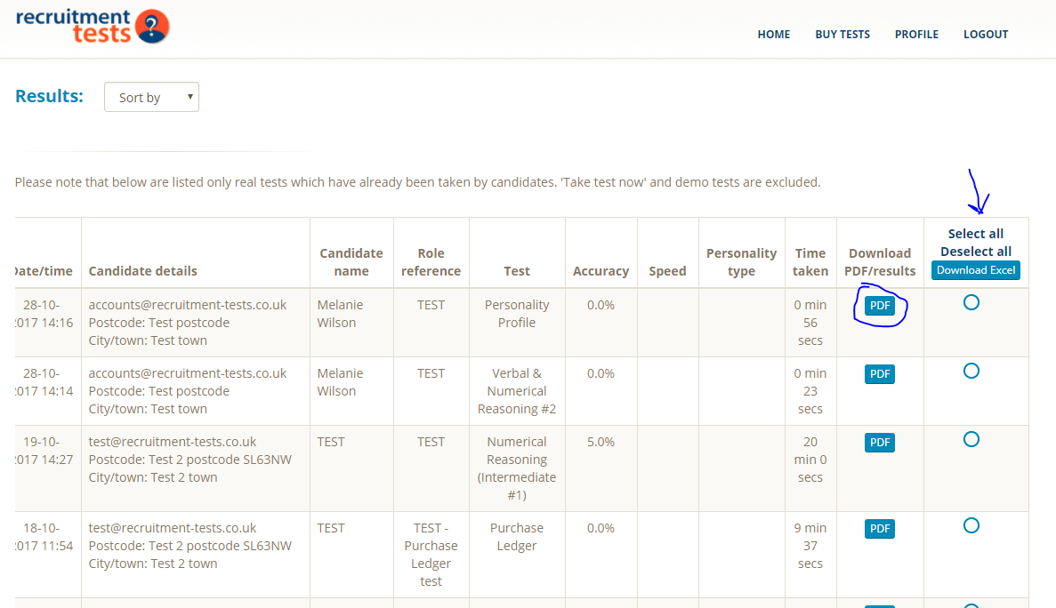
Copy PDF results and downloadable table

Slide 15
If you would prefer your candidates to take the test in your office (e.g. Assessment Centre) rather than at home you can send ‘indirect’ by choosing your spare office computer email address inbox and the candidates name. The candidate sits at that computer and opens the one test one email and click the link when ready to start the test.
The results area will show names as well as email
Please be careful to complete the candidate's name to identify the test later
Please note only one candidate at a time using this indirect method but the form stays completed after the test is sent to allow for a quick edit and resend to a different candidate name

Slide 16
Q&A – Some clients have asked us the following questions, the answers may help you too:
Q: Do emails go to direct to candidates or us, the recruiting company?
  A: The candidate receives email log in link from test@recruitment-tests.co.uk
Q: Do we need to notify the candidate about a test they need to take?
  A: Candidate will receive an email once you send out the test but it doesn’t harm to ask them to look out for an email in case it lands in their SPAM box for instance.
Q: Do I have an option for the candidate not to receive the test results?
  A: Yes you have an option to switch off the ‘candidate receives the test results’ when sending the tests.
Q: What if I prefer not to receive all candidate test results to my email?
  A: You can simply insert test@recruitment-tests.co.uk in the test results email address and pick up results in the test results table on the testing portal instead. You can then also download all results to a spreadsheet.
Q: If we send a batch to candidates can we close the test at a particular time on a certain day?
  A. Yes there are two ways of doing this: you either
  1) Go to ‘results analysis’ tab on Testing Portal and download table of results at close time. Or
  2) You delete outstanding tests from ‘outstanding tests’ tab.

Slide 17
Other features
Just a reminder on the other things we have added to make your experience with us better.
Pre Mixed Tests for you to use now (e.g. Numeracy with Attention to detail)
A new Mixed Test for you if you need
Your questions/tests on our portal – uploaded by us.
Your logo on all test results
Bulk upload of candidates by you or us
Additional field on test results – e.g. location of your candidate so you can work out their commute.
Reasonable adjustments can be made for disadvantaged applicants e.g. extra time.
Obtain test link from outstanding tests area if email is missing – no resend.
Multi user access - Share one account or have multiple no extra charge your choice
Results auto marked and back to you in 10 minutes. 24/7/365
Edit the email candidates get with the test link.
Paypal or in arrears invoicing monthly
Download results table and league table
GDPR and Employee Engagement testing to bring up own staff knowledge www.iiop.co.uk

Slide 18
Having found Recruitment tests on the web the entire process has been fantastic and the team have made it so easy for us to get started.
We are now using the tests and are seeing the benefit.
I would suggest that anyone searching for a solution makes sure they use these guys
Recommendation on LinkedIn from Simon at Total Motion
If we have missed anything please be sure to
email us on info@recruitment-tests.co.uk

Slide 19
We would be so pleased if you would connect with us on Linkedin for more information and recommendations.
Kind regards,
Jesse, Denise, James, Rahul, Sarah, Sharaz
+the rest of the RT team
https://www.linkedin.com/in/denise-spencer-7a3105179/
https://www.linkedin.com/in/jesse-lawson-a545874b/

